Slide 1
ECC & ECDSA: Encryption, Decryption, and Signing
Blockchain & Cryptocurrency
F. M. Shefat Hossain Niloy- 0122310011
Jamil Uddin Bhuiyan - 0122410061

Slide 2
🔐 Understanding ECC & ECDSA
A Secure Cryptographic System

Slide 3
What Are ECC and ECDSA?
Elliptic Curve Cryptography (ECC):
- A form of public key cryptography based on elliptic curves.
- Secure and uses smaller keys than RSA.
ECDSA (Elliptic Curve Digital Signature Algorithm):
- Used to sign messages securely.
- Common in cryptocurrencies like Bitcoin & Ethereum.

Slide 4
ECC vs RSA - Key Size Comparison
🔹 ECC provides the same security as RSA but with smaller key sizes.
🔹 256-bit ECC key = 3072-bit RSA key.
🔹 This makes ECC more efficient and faster for encryption.

Slide 5
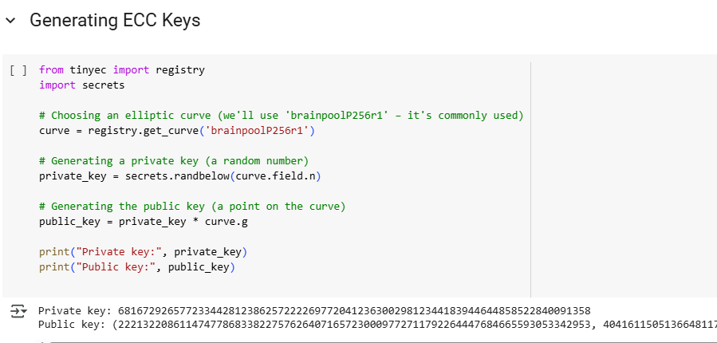
ECC Key Generation - Code & Output

Slide 6
Explanation: ECC Key Generation
ECC uses a special mathematical curve to generate a key pair.
The private key is a randomly generated number.
The public key is derived using the private key and elliptic curve multiplication.
This key pair is essential for encryption, decryption, and digital signatures.

Slide 7
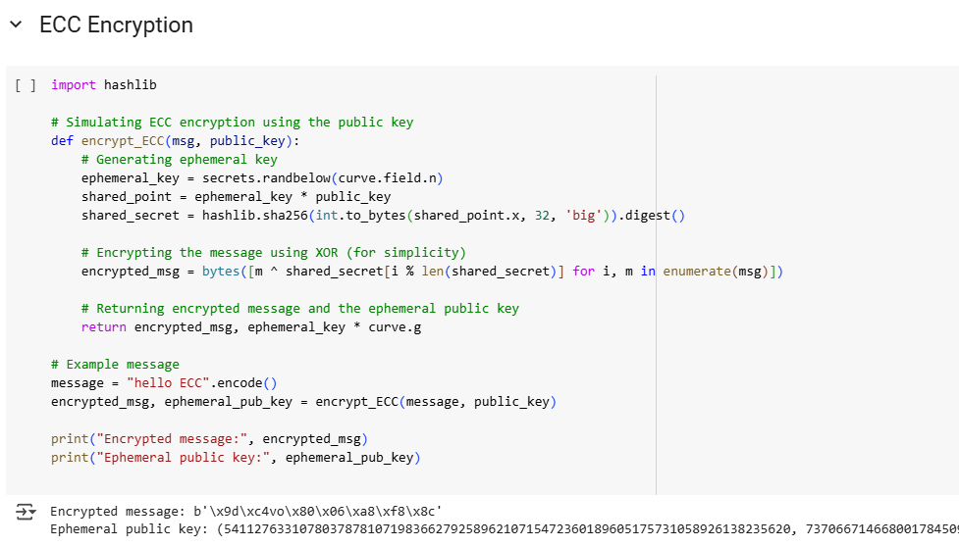
ECC Encryption - Code & Output

Slide 8
Explanation: ECC Encryption
The sender generates a one-time temporary key for security.
A shared secret is computed using the recipient’s public key.
The message is encrypted using XOR operation and the shared secret.
The ephemeral public key is sent along with the encrypted message.

Slide 9
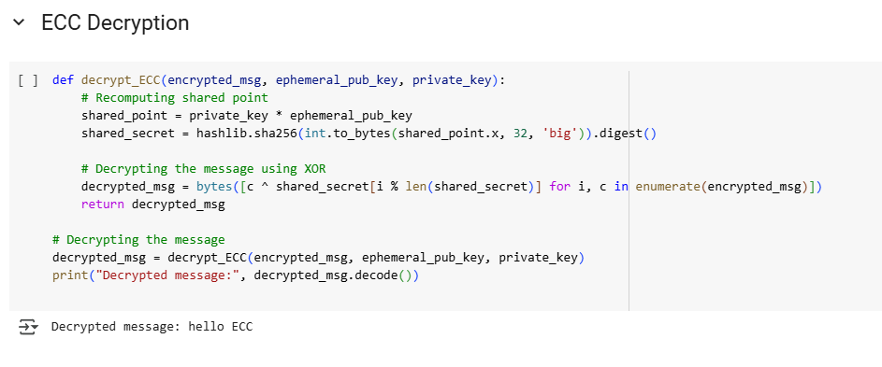
ECC Decryption - Code & Output

Slide 10
Explanation: ECC Decryption
The receiver uses their private key to derive the same shared secret.
Using the shared secret, the encrypted message is decrypted via XOR.
This ensures that only the intended recipient can read the message.

Slide 11
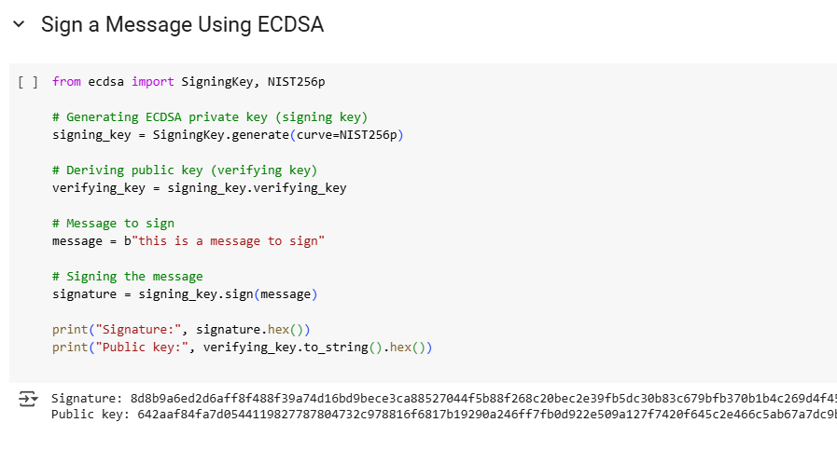
ECDSA Signing - Code & Output

Slide 12
Explanation: ECDSA Signing
ECDSA (Elliptic Curve Digital Signature Algorithm) is used to sign messages.
The sender creates a digital signature using their private key.
This signature ensures the authenticity and integrity of the message.

Slide 13
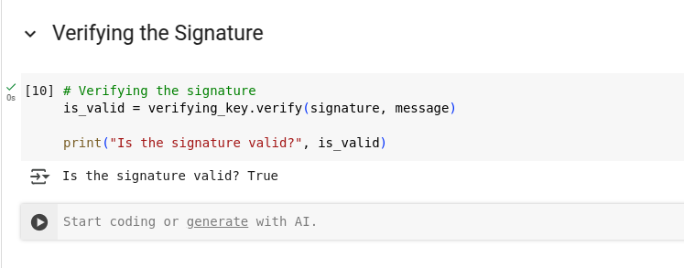
ECDSA Verification - Code & Output

Slide 14
Explanation: ECDSA Verification
The receiver uses the sender’s public key to verify the signature.
If the verification is successful, the message is authentic and unaltered.
This is widely used in blockchain transactions to ensure integrity.

Slide 15
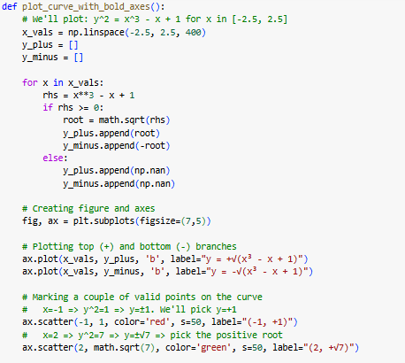
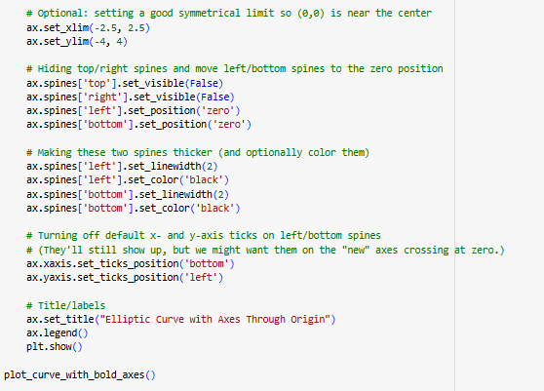
Visualizing the S-Shaped Elliptic Curve ( Code )

Slide 16
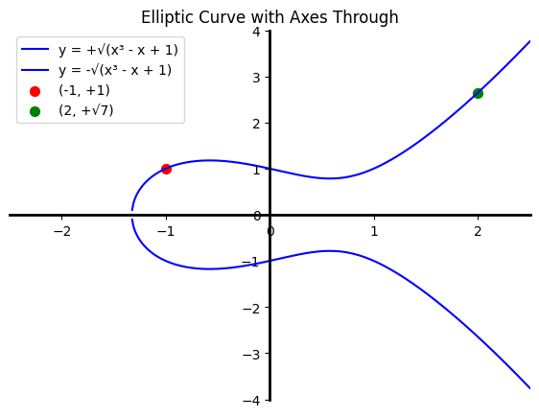
Visualizing the S-Shaped Elliptic Curve
The curve shown is: y² = x³ - x + 1
This elliptic curve has a smooth S-like shape.
The curve is symmetric about the x-axis and passes through key points like (-1, 1) and (2, √7).
Visualizing this helps in understanding how ECC uses elliptic curves over finite fields.

Slide 17
Reference:
Link of the project : https://colab.research.google.com/drive/1sqNf109A0FVmNt7Gegphup7zkpOtd8la?usp=sharing

Slide 18
Thank You

